Slide 1
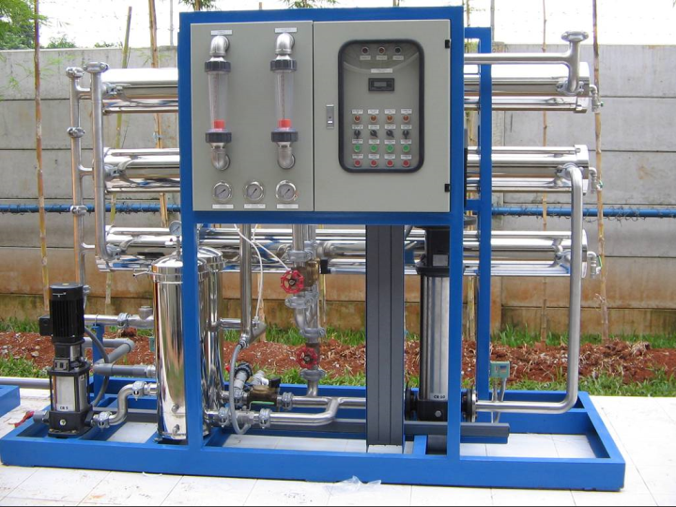

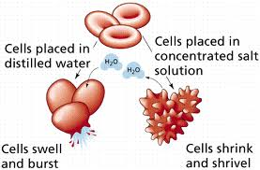
CHEM 450/450G
Dr. M. J. Nee
Lecture II-6
Phase Change in Solutions: Colligative Properties
Plan for Today:
Chemical Potential and Phase Change
Vapor Pressure Lowering
Changes to phase change temperatures
Osmotic Pressure
Electrolyte Solutions

Slide 2
Solutions and Chemical Potential
We can express the chemical potential of component i in the solution by adding a mixing term to the chemical potential of the pure solvent:
Remember, μ_{i} = G_{i,m}, so we can always just go to the tables to find μ_{i}*.
Why might we want to do this?

Slide 3
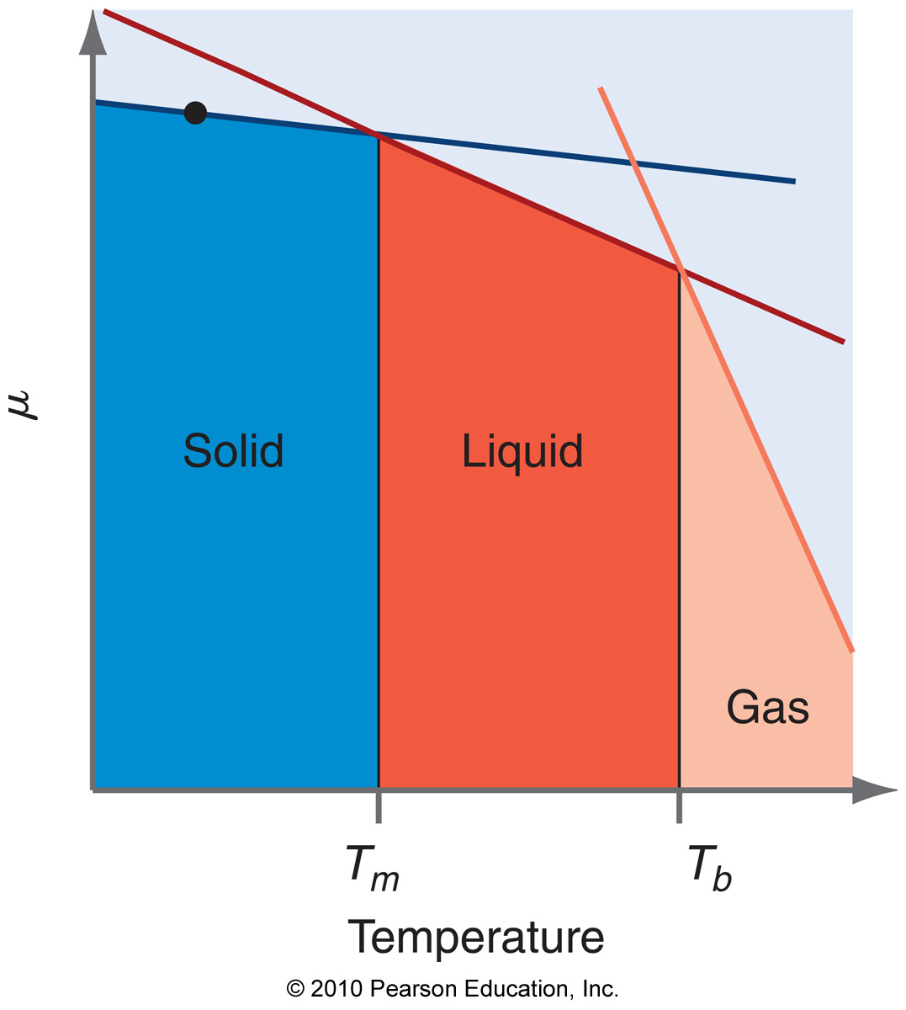
Colligative properties
Colligative properties are those that depend only on the concentration of the solute, not on its identity. Regardless of what the solute is, it alters μ_{solvent}:
Note that the slope of μ doesn’t change!

Slide 4
Vapor Pressure Lowering
Just Raoult’s Law restated:
Arises because chemical potential of the solvent is reduced by the presence of solute, so that the difference in μ (liquid vs. vapor) is larger:

Slide 5
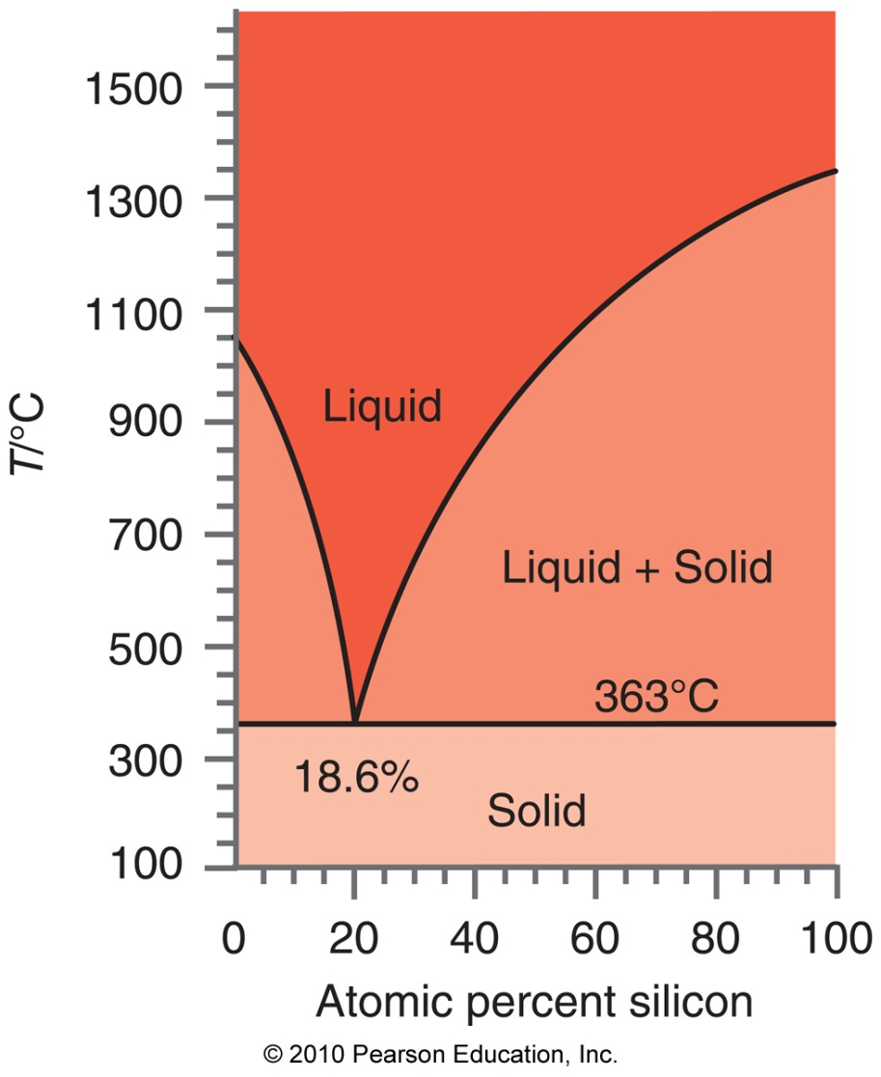
Solid-solution equilibrium
For dilute solutions, the solute begins to freeze out at T, defined by
where T*_{fus} and ΔH*_{fusion,m} are the freezing T and ΔH of the pure solvent, respectively.
How could we determine the eutectic temperature, T_{E}?

Slide 6
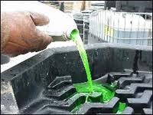

Freezing point depression
This is why antifreeze works. There’s nothing special about ethylene glycol, though, other than its solubility in water, and low molar mass.
ΔT_{f} = change in freezing temperature
M_{solvent} = molar mass of solvent (kg/mol)
T*_{fusion} = freezing temperature of pure solvent
ΔH*_{fusion,m} = molar enthalpy of fusion for pure solvent
m_{solute} = molality of solute

Slide 7
Boiling Point Elevation
This is exactly analogous, except that T_{b} is increased:
K_{f} and K_{b} are called the crysocopic constant, and the boiling point elevation constants, respectively

Slide 8
Osmotic Pressure
The origin of osmotic pressure is a differential in chemical potential on either side of the membrane.
Solvent flows across the membrane in an attempt to equilibrate the chemical potential

Slide 9
The van’t Hoff equation
As with the S-L coexistence region, we can no longer assume that the compressibility is negligible: We treat chemical potential as μ(T,P) to derive
apply pressure
Sea water
Fresh water

Slide 10
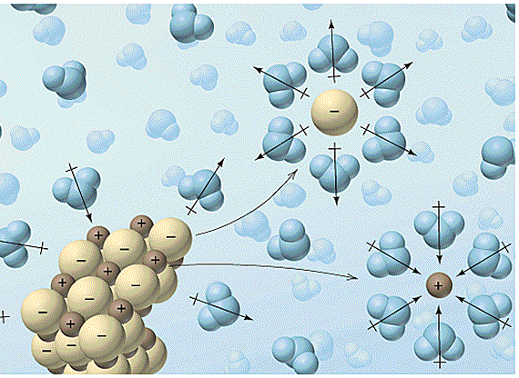
Electrolytes in solution
Electrolytes have a formula unit, not a molecular formula: when you have 100 Na⁺ and 100 Cl⁻ in a crystal, you break the equivalent of 100 NaCl bonds.
Cannot have a solution of cations, or a solution of anions: the solution is both together... and neutral.
Dissociation is favored when entropic gain outweighs enthalpic input to “break” bond

Slide 11

Thermodynamics of dissociation
All thermodynamic state functions (ΔG°_{f} , ΔH°_{f,} S°) are referenced to H⁺ = 0 for ions.
Gibbs Energy for dissociation is defined in the same way as before, using a reaction like:
If ΔG_{R} < 0, the reaction is spontaneous, so the electrolyte is “soluble”

Slide 12
Ideal Electrolyte Solutions
Colligative properties depend on number of particles, so for electrolytes, there are
particles in solution for every mole of X_{a}Y_{b} dissolved.

Slide 13
Ion Pairs and Degree of Dissociation
When ion pairs form, they are effectively single particles, so the total colligative effects from such solutions are in fact reduced.
ion pair
The degree of dissociation, α, is defined as:

Slide 14
The van’t Hoff Parameter: Ion-contact pairs
The value i is called the van’t Hoff Parameter.
Although i is certainly a function of the Gibbs energy of solvation, it is not easily calculable. In fact, colligative properties are often used to determine it.

Slide 15
Colligative properties: Electolytes
To correct for this reduced particle number, we use i to correct our previously used concentration parameters. For dilute electrolyte solutions, i≈v, so use the stoichiometric coefficients:

Slide 16
Finish reading Chapter 9. We will spend a day on activity and real solutions, then another on electrolyte solutions. Exam 2 is Tuesday, November 1.
HW 6 is due on 10/22.

